Slide 1
Map your documents
Colleen Alber, Product Evangelist
Notes:
Good morning!

Slide 2
Maps will change how you see the world

Slide 3
Hyland Offices
Andover, MA
Charlotte, NC
Irvine, CA
Lansing, MI
Lincoln, NE
Phoenix, AZ
Salt Lake City, UT
Tampa, FL
Westlake, OH
Melbourne, AU
Sydney, AU
Jundiai, BR
Sao Paulo, BR
Santiago, CL
Tokyo, JP
Zug, CH
London, UK
Notes:
Take for example a LIST of Hyland offices…

Slide 4


Slide 5
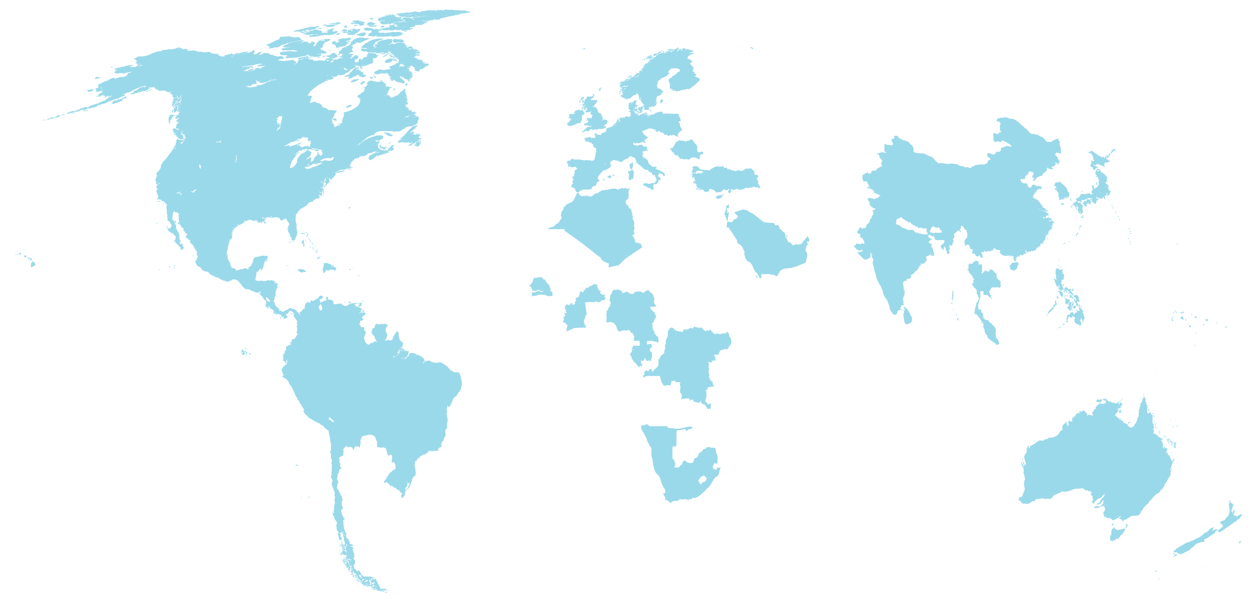

Slide 6
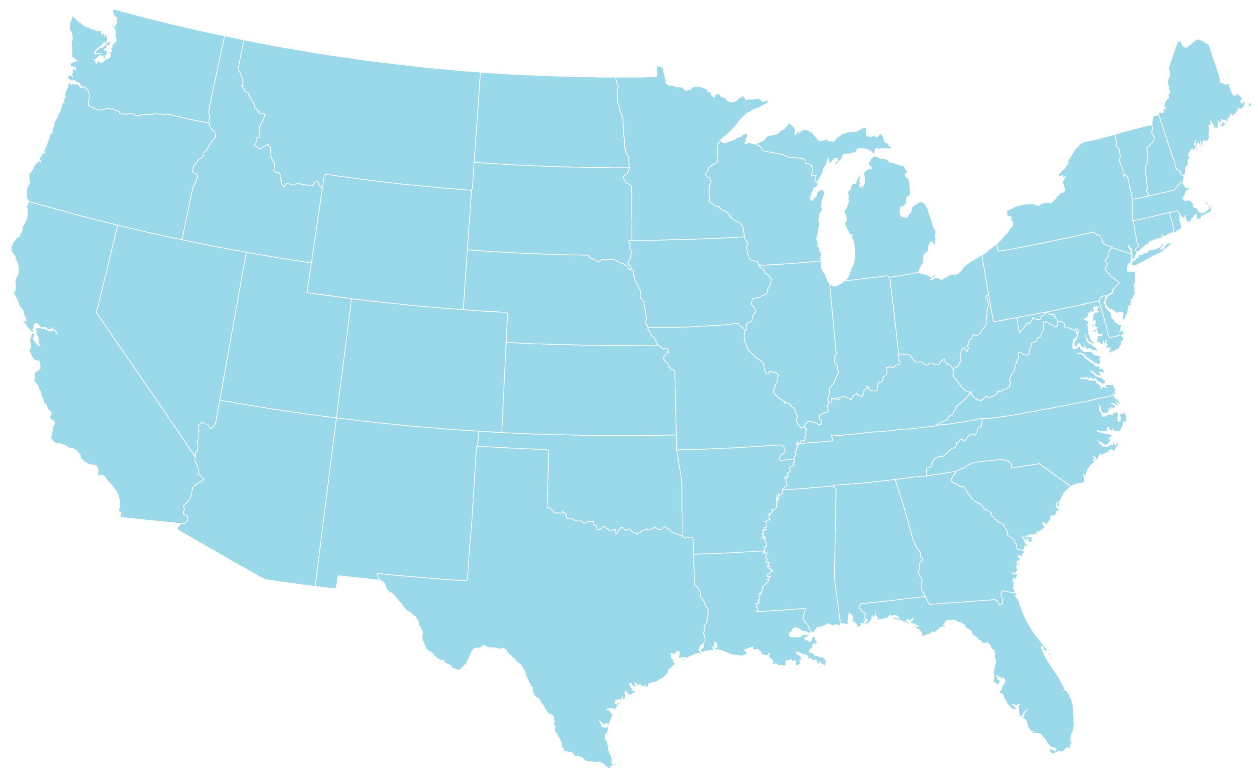

28°F
24°F
35°F
29°F
45°F
57°F
59°F
64°F

Slide 7











Tampa Office
5404 Cypress Center
Suite 140
Tampa, FL 33609

Slide 8
A picture is worth a thousand words
Notes:
The moral of the story goes back to the old adage….a picture is worth a thousand words
Now, what does this all have to do with OnBase??? …well similarly, modern map technology can enable our CUSTOMERS to make better business decisions.

Slide 9
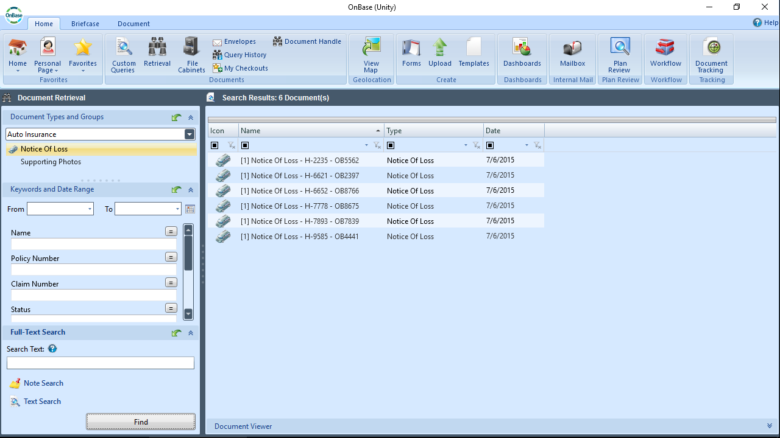
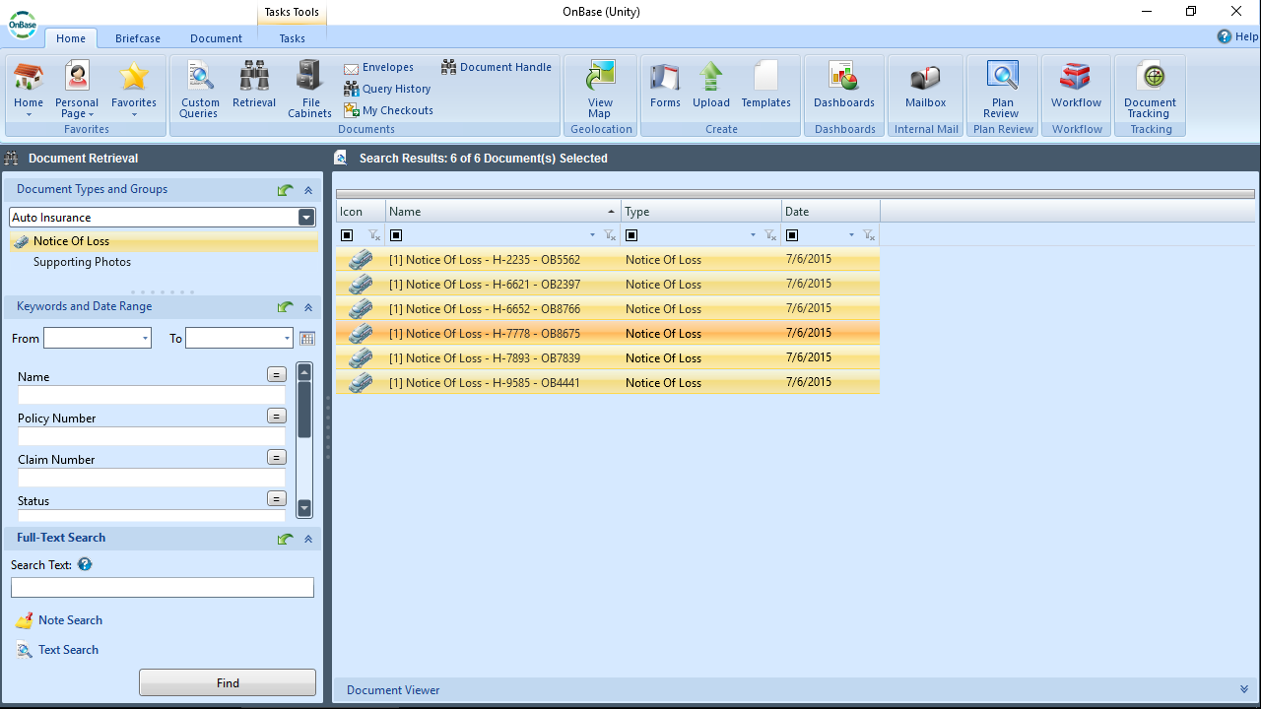
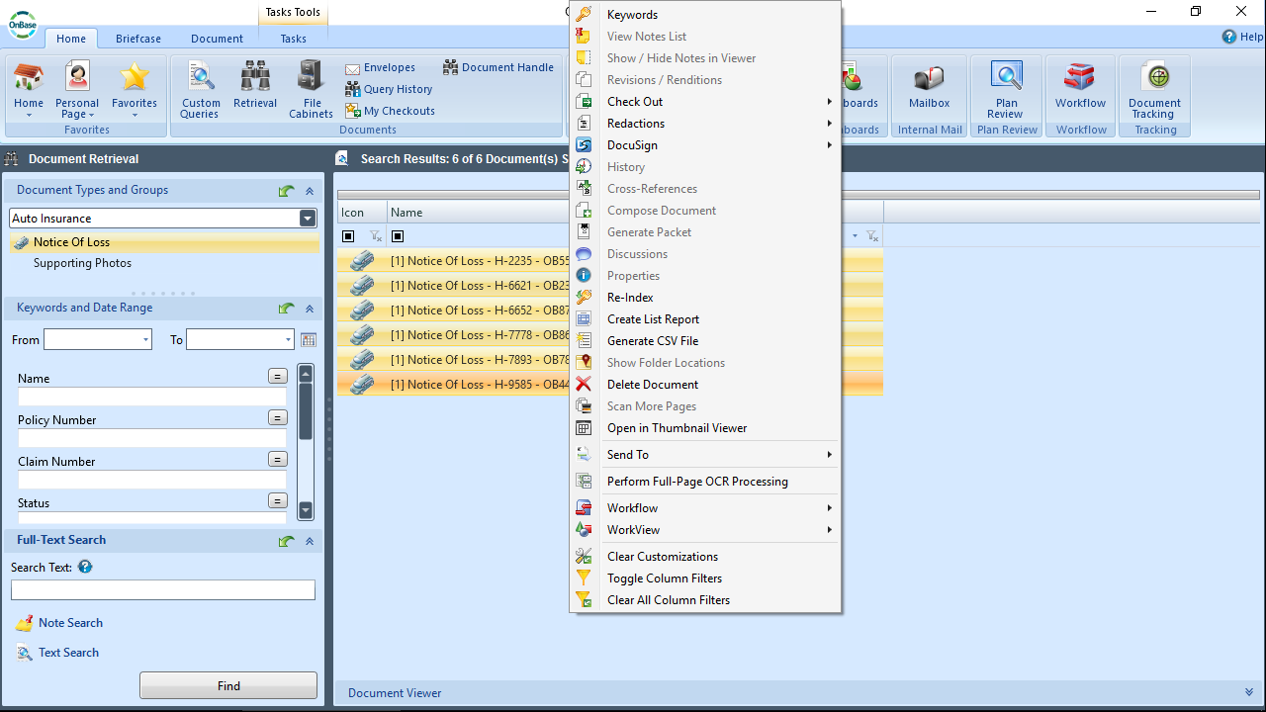
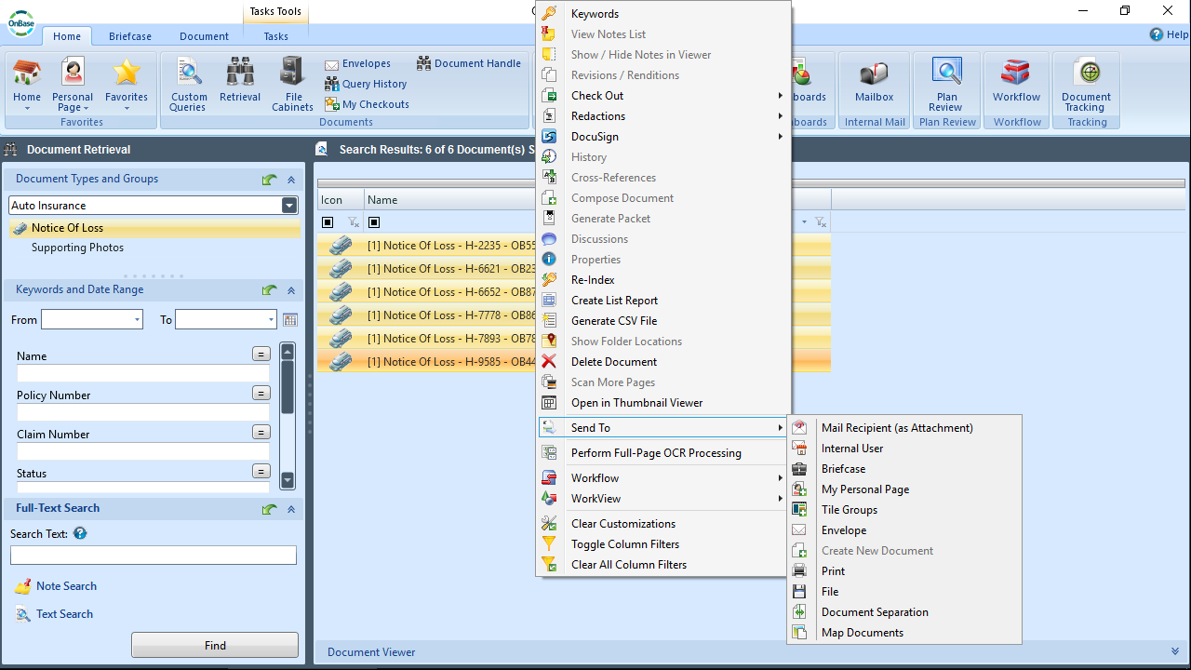
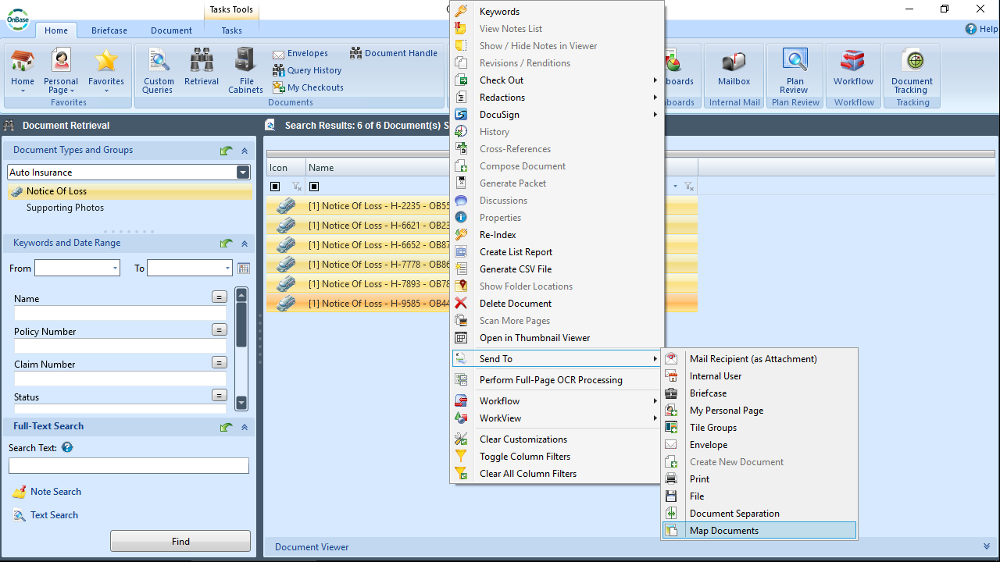
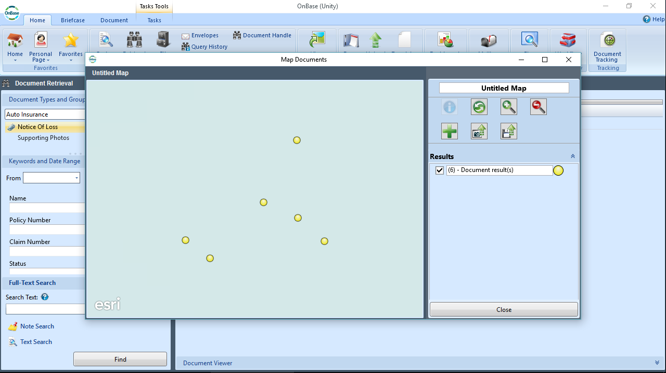
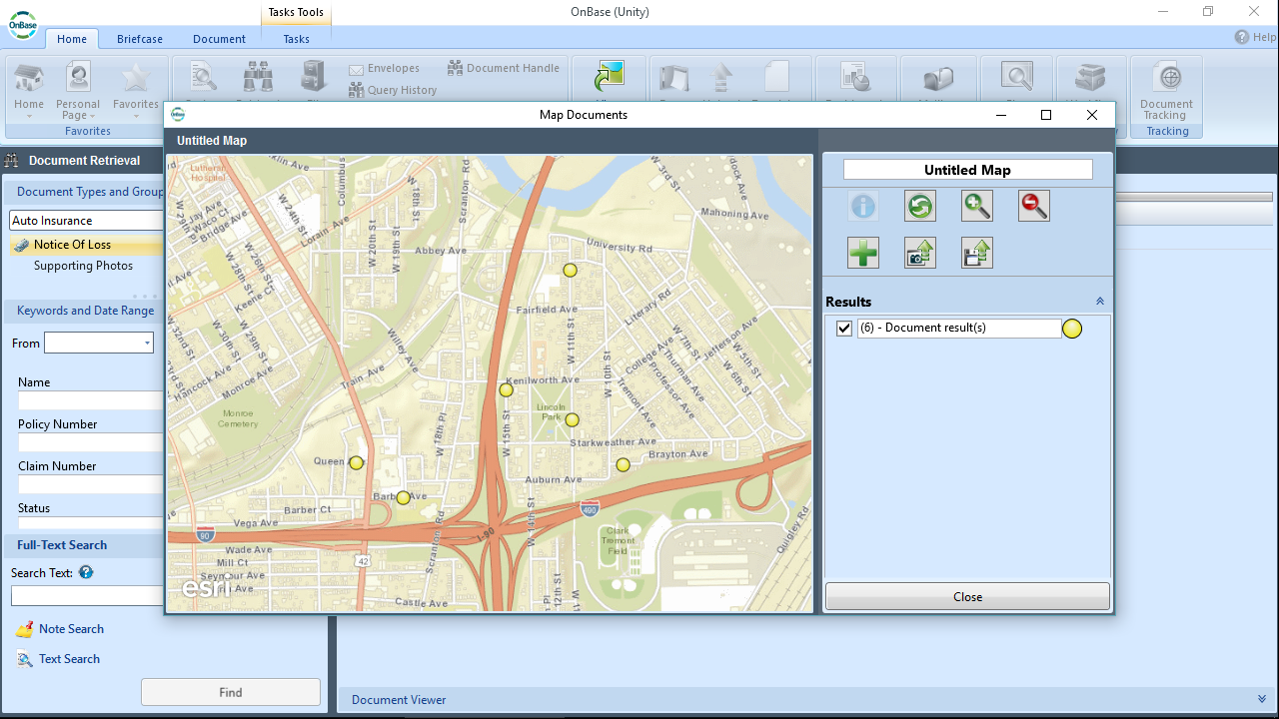
Notes:
We’re all familiar with a list of documents.
Since OnBase 15, we’ve integrated Unity with Esri, allowing users to dynamically display and PLOT these documents on an interactive Esri map. In order to make this happen, we need FOUR address keywords, geocode on the fly, anywhere in the world, international out of the box

Slide 10
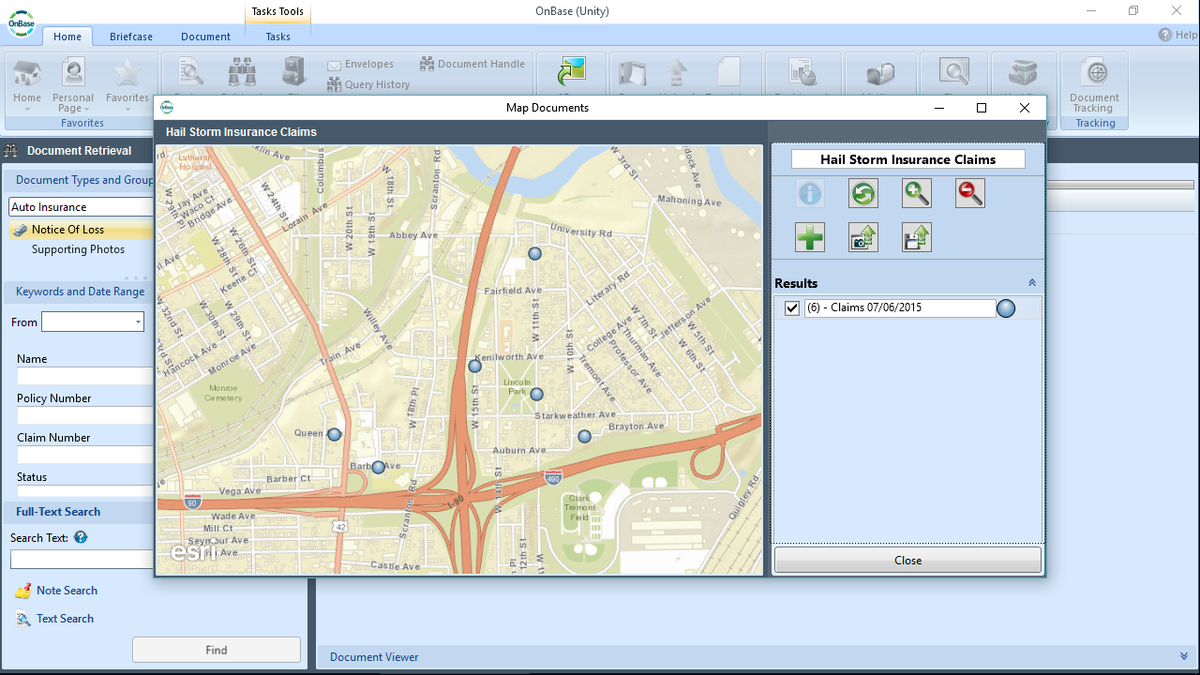
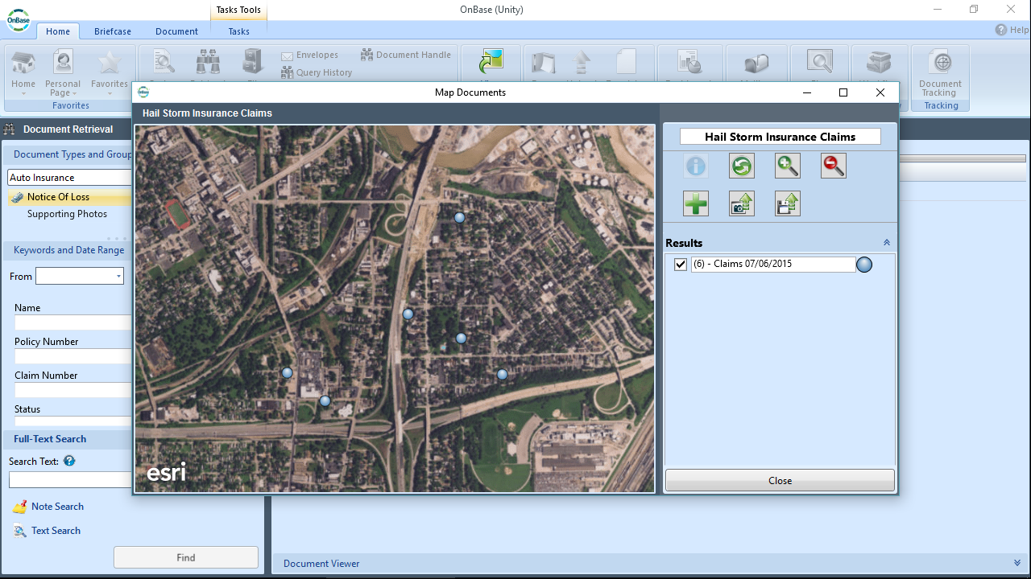
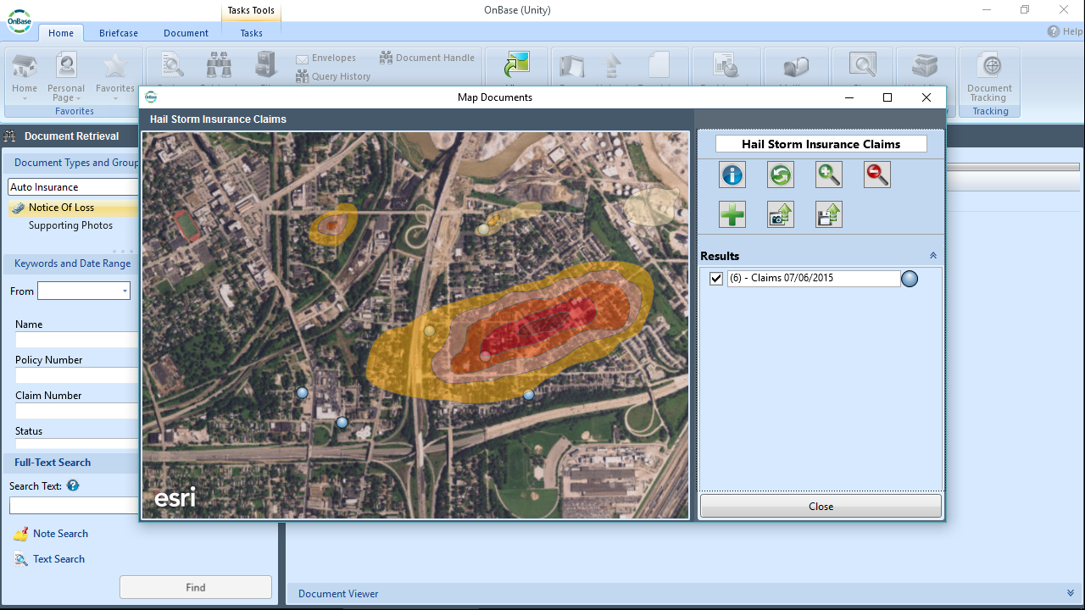
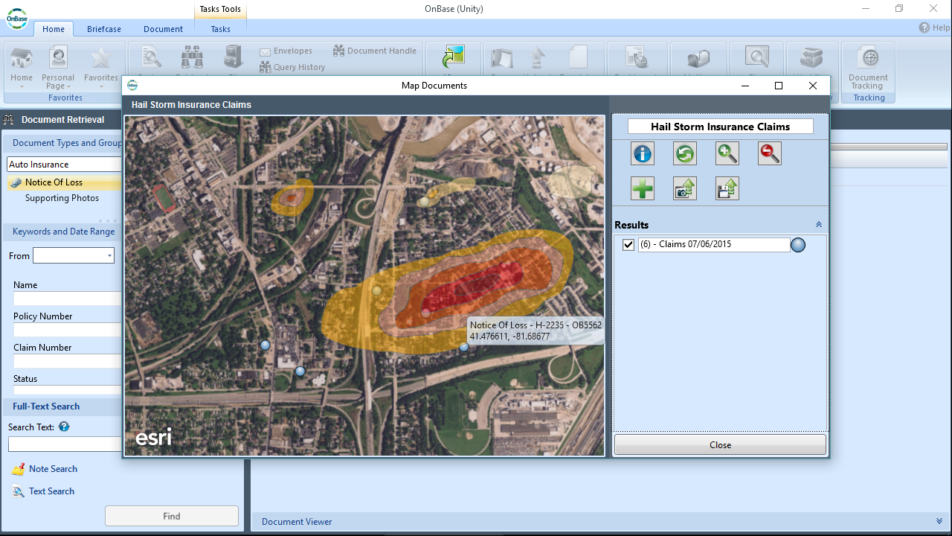
Notes:
Users can even ADD external (non-OnBase data) to the map…so now we seen our insurance claims plotted and paired with weather data…here a heat map that showcases where a violent storm took place…
And we can easily see which claims are legitimate, which aren’t and which might require further investigation…the WHERE becomes important…we can hover over the document to get its autoname

Slide 11
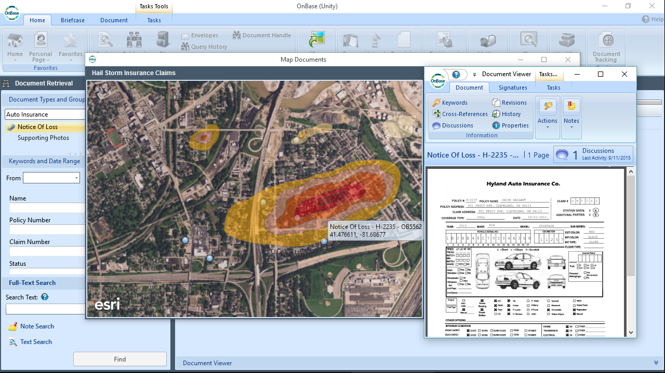
Map Documents in Unity
Notes:
Or click on a pinpoint to retrieve the document. In OnBase we have the history, mapping brings the geography into the picture. This is a huge. This is a “complete view”.

Slide 12
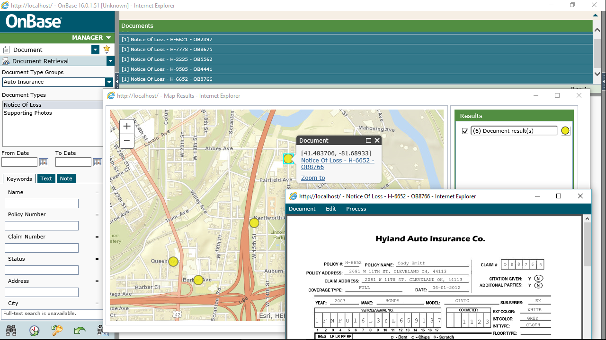
NEW in 16
Map Documents in Web
Notes:
In OnBase 16, we’ve extended this same functionality to the Web Client….only from Retrieval
…and in this case, while maybe not as feature rich, there is ZERO footprint on the workstation…not from OnBase, not from Esri.

Slide 13
Maps more powerful
b/c of completeness of data behind them

Slide 14

Integration for Esri
Notes:
While what I’ve just described, is NEW. We’ve actually been integrating with Esri since 2003…bringing OnBase documents, forms and features to the Esri map…click on a piece of the map (feature attribute) and display related documents from OnBase.

Slide 15
Integration for Esri
Notes:
What about our users that LIVE on the map/Esri….
Here I see a map of northeast Ohio paired with a diversity index…along with possible candidates…I find the one best suited and can instantly retrieve related documents form OnBase, such as an application…but I can also upload documents, take pictures, submit forms and all from a mobile device too! This of a property inspector or field adjuster!
Also ability to attach documents to map, take pictures, submit forms….from MOBILE too
And notice my browser, GOOGLE CHROME, new in 16

Slide 16
Maps made possible
with or without Esri
Notes:
Mapping makes graphical reporting and location analytics possible
And this isn’t all…we’re bringing more GIS concepts (that customers can use whether they have Esri or not)….

Slide 17
Capture Geolocation
Mobile Access – captures Geolocation data!
    Upload document
    Create new E-Form
    Create new Unity Form
DIP – includes Geolocation data!
NEW in 16
Notes:
Mobile can capture latitude and longitude and store geolocation.
By storing the geolocation, they can see that an onsite visit had taken place at the correct location and that it actually did take place in a certain location. Example user, but not limited to a field adjuster.
We are making product feature and database changes to capture and store geolocation data!!

Slide 18
Reporting Dashboards
Heat and Choropleth maps – existing!
Bubble, Pie and Geo Point maps – new in 16!
NEW in 16
Notes:
Reporting Dashboards includes choropleth maps and shape files that can display information visually on a map…where documents originated, located, trends, density
The heat maps and choropleth maps that use simple state, postal codes along with calculated fields to total and display information
(state, postal code, lat/long coordinates bind documents to map)
OnBase is cheap reporting! Esri data or OnBase data or both!

Slide 19
Vendor Invoice Amt by Geolocation

Slide 20
1
Integration for Esri
1
2
Reporting & analysis
2
3
Future technology
3
Notes:
So when talking to customers…what’s important to know. Three things.

Slide 21
ESRI
CLOUD
CLINICAL CONTENT
GUIDEWIRE
GIS
CASE MANAGEMENT
ENTERPRISE READINESS
FULL TEXT W/ DTSEARCH
MACKINAC
Notes:
Remember the product program word cloud from the annual meeting? Both ESRI and GIS are a on our development roadmap…meaning that we are committed to innovating with this technology.

Slide 22
Map on!
Notes:
Hope you’re eager, cause what we’re doing here at Hyland absolutely rocks.

